Slide 1

The Inductive Games
Hack Cu X
Spencer Wilson

Slide 2
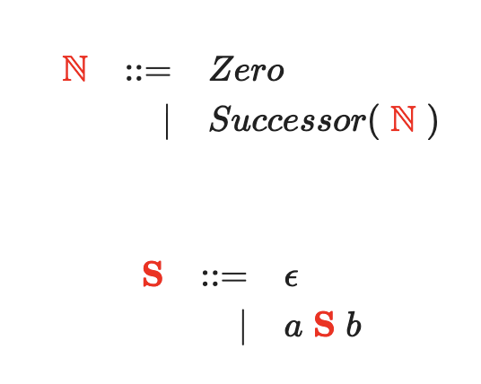
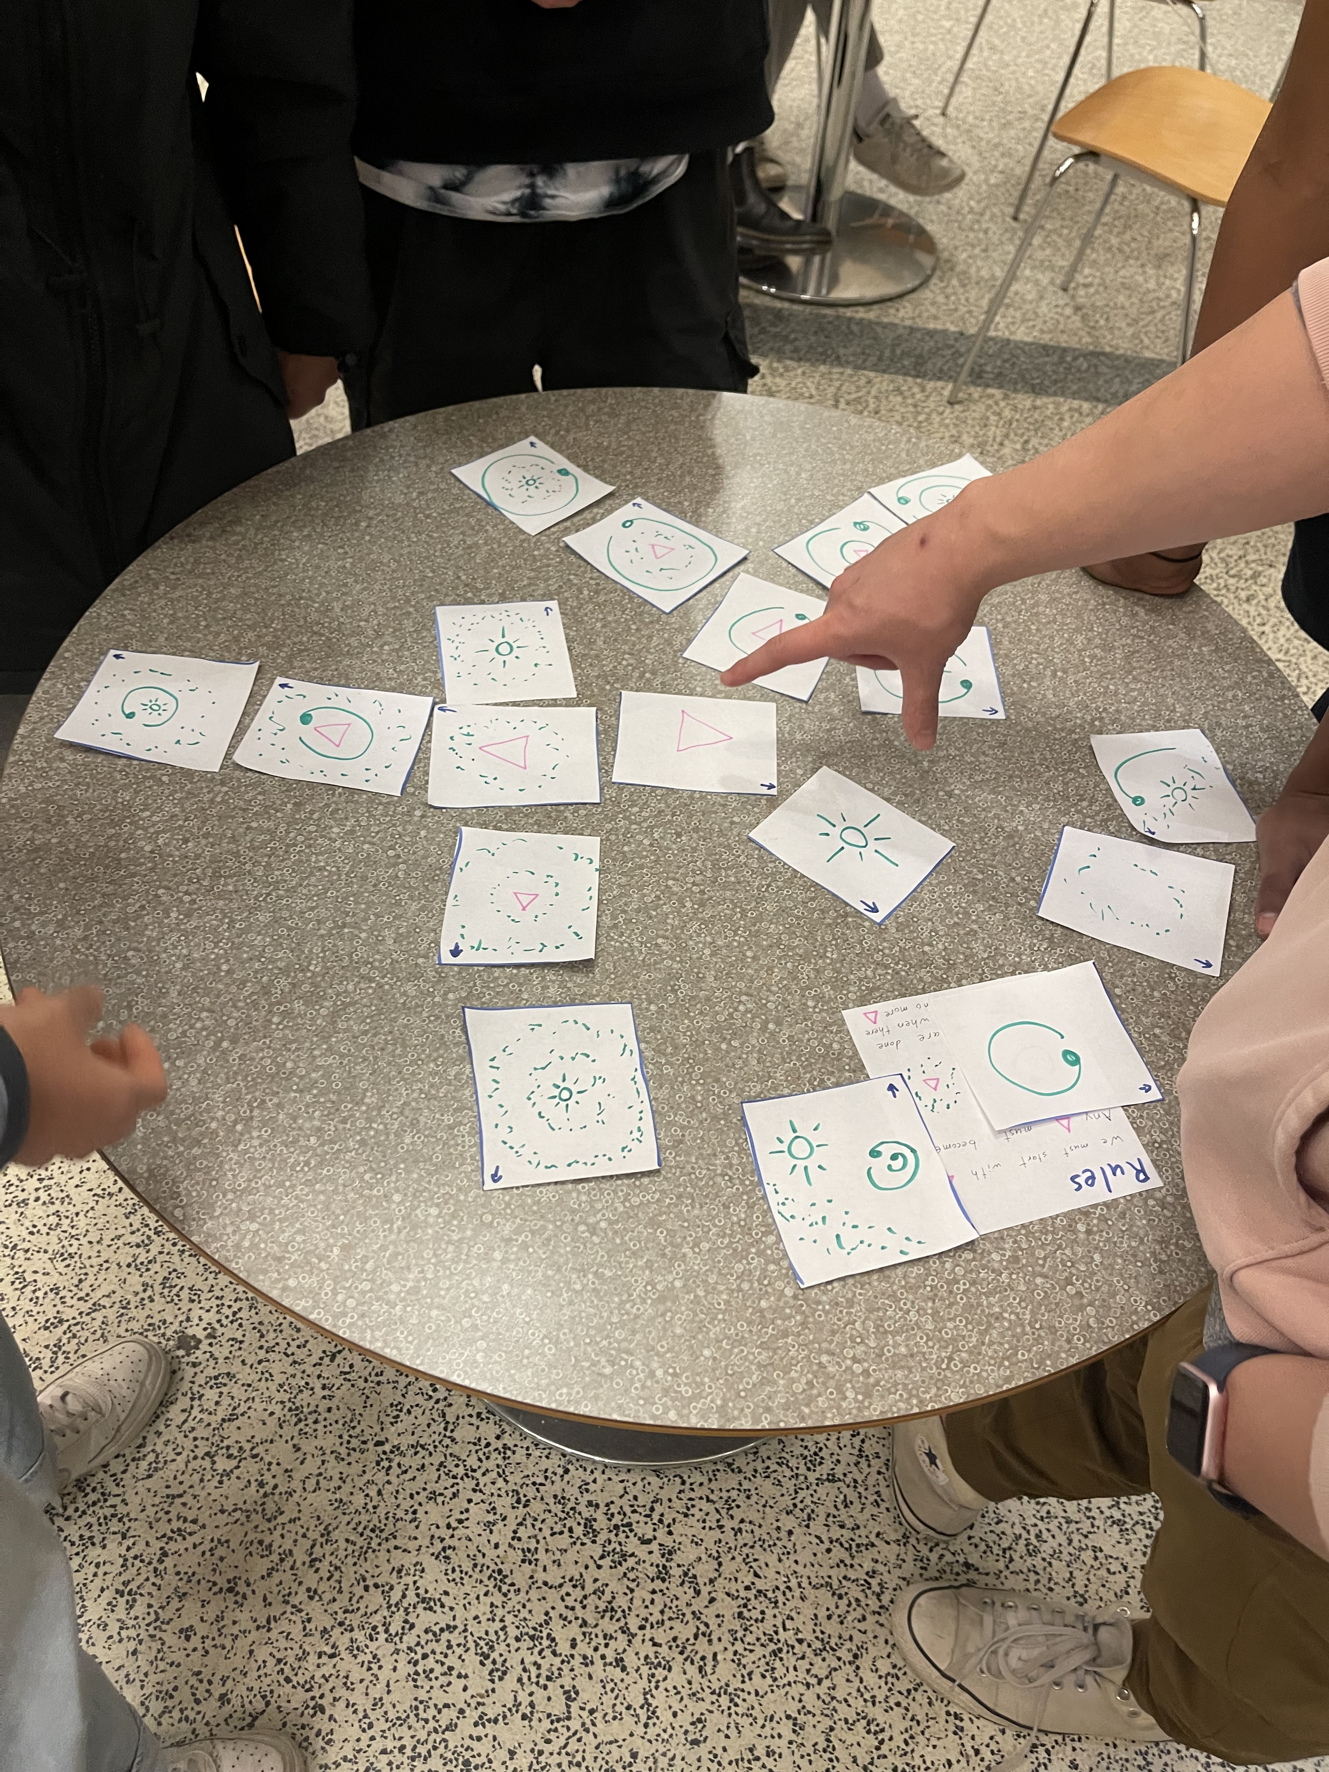
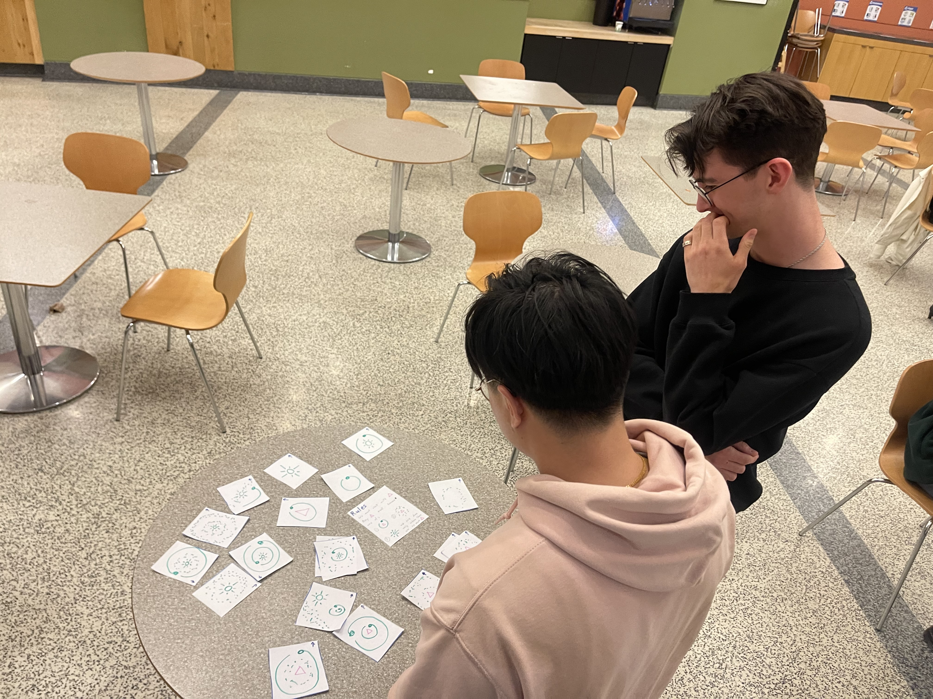
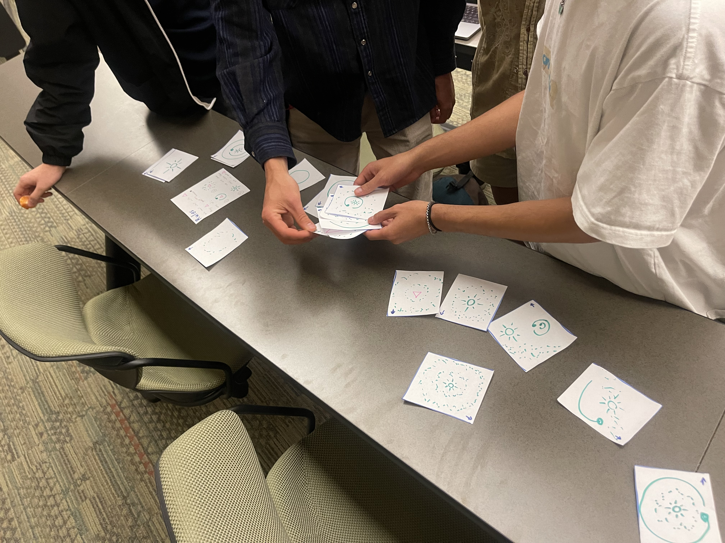
Induction can be hard to learn
The Old Way
Our Method
N => Zero
N => S(N) => S(Z)
N => S(N) => S(S(N)) => S(S(Z))
N => S(N) => S(S(N)) => S(S(S(N))) => S(S(S(Z)))
…
S => ‘’
S => aSb => ab
S => aSb => aaSbb => aabb
…

Slide 3
Make Your Own Game

Slide 5
Solar Induction

Slide 6




Rules:
Make what you can given:
Should become either:

Slide 7

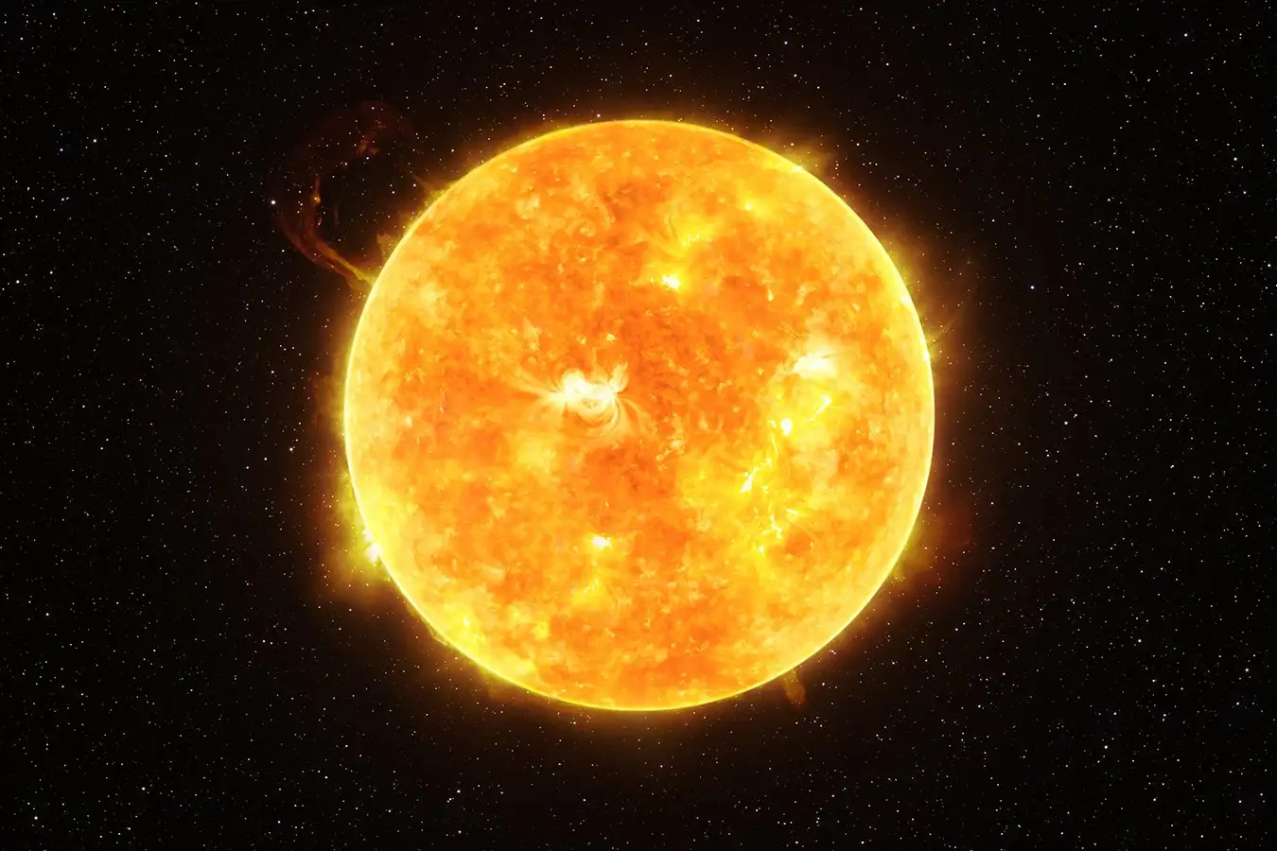

Slide 9
Link List Laugh

Slide 10
Rules:
100
Make what you can given:
25
N should be a number
Should become either:
n
100
100
100
25

Slide 11
100
100
25
25
25
789
789
789
789
789

